Slide 1

DATABASE MANAGEMENT SYSTEMS
CASE STUDY
Group-10

Slide 2

What is a NoSQL database?
NoSQL databases are interchangeably referred to as “nonrelational,” “NoSQL DBs,” to highlight the fact that they can handle huge volumes of rapidly changing, unstructured data in different ways than a relational (SQL) database with rows and tables.

Slide 3



Contd...
It's important to emphasize that the "No" in "NoSQL" is an abbreviation for "not only" and not the actual word "No." This distinction is important not only because many NoSQL databases support SQL like queries, but because in a world of microservices and polyglot persistence, NoSQL and relational databases are now commonly used together in a single application.

Slide 4

Benefits of Introducing NoSQL Databases
Store heap of data that might not have a structure
Speed up the development process
Reap the benefits of cloud computing and storage
Elevate horizontal scalability

Slide 5


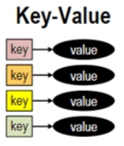
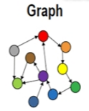
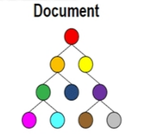
Types of NoSQL Databases:
Key-value Pair Based
Column-oriented Graph
Graphs based
Document-oriented

Slide 6

Advantages of NoSQL
Can be used as Primary or Analytic Data Source
Big Data Capability
No Single Point of Failure
Easy Replication
No Need for Separate Caching Layer
It provides fast performance and horizontal scalability.
Can handle structured, semi-structured, and unstructured data with equal effect
Object-oriented programming which is easy to
use and flexible

Slide 7
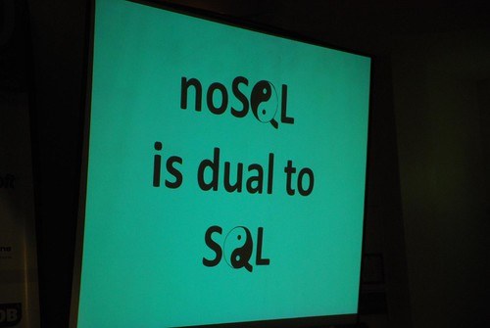
NoSQL databases don't need a dedicated high-performance server
Support Key Developer Languages and Platforms
Simple to implement than using RDBMS.
It can serve as the primary data source for online applications.
Handles big data which manages data velocity, variety, volume, and complexity.
Excels at distributed database and multi-data center operations.
Eliminates the need for a specific caching layer to store data
Offers a flexible schema design which can easily be altered without downtime or service disruption

Slide 8
Disadvantages of NoSQL
No standardization rules
Limited query capabilities
RDBMS databases and tools are comparatively mature
It does not offer any traditional database capabilities, like consistency when multiple transactions are performed simultaneously.
When the volume of data increases it is difficult to maintain unique values as keys become difficult
Doesn't work as well with relational data
The learning curve is stiff for new developers
Open-source options so not so popular for enterprises.

Slide 9

CHOOSING NOSQL OVER SQL :
On the basis of reliability, rational models are useful but not in terms of systems which involve huge amount of data; in such cases, non-relational models are much more useful. To store large chunks of data, NoSQL databases are used. NoSQL databases are scalable and wide ranged because they are non-relationally distributed.
There are a lot of advantages of NoSQL which not only involve its own features but also some features of relational database management system. The severe benefit of NoSQL database is that it is an open-source system which helps to adapt many numbers of features for newly generated applications.

Slide 10

THANK YOU

